Slide 1
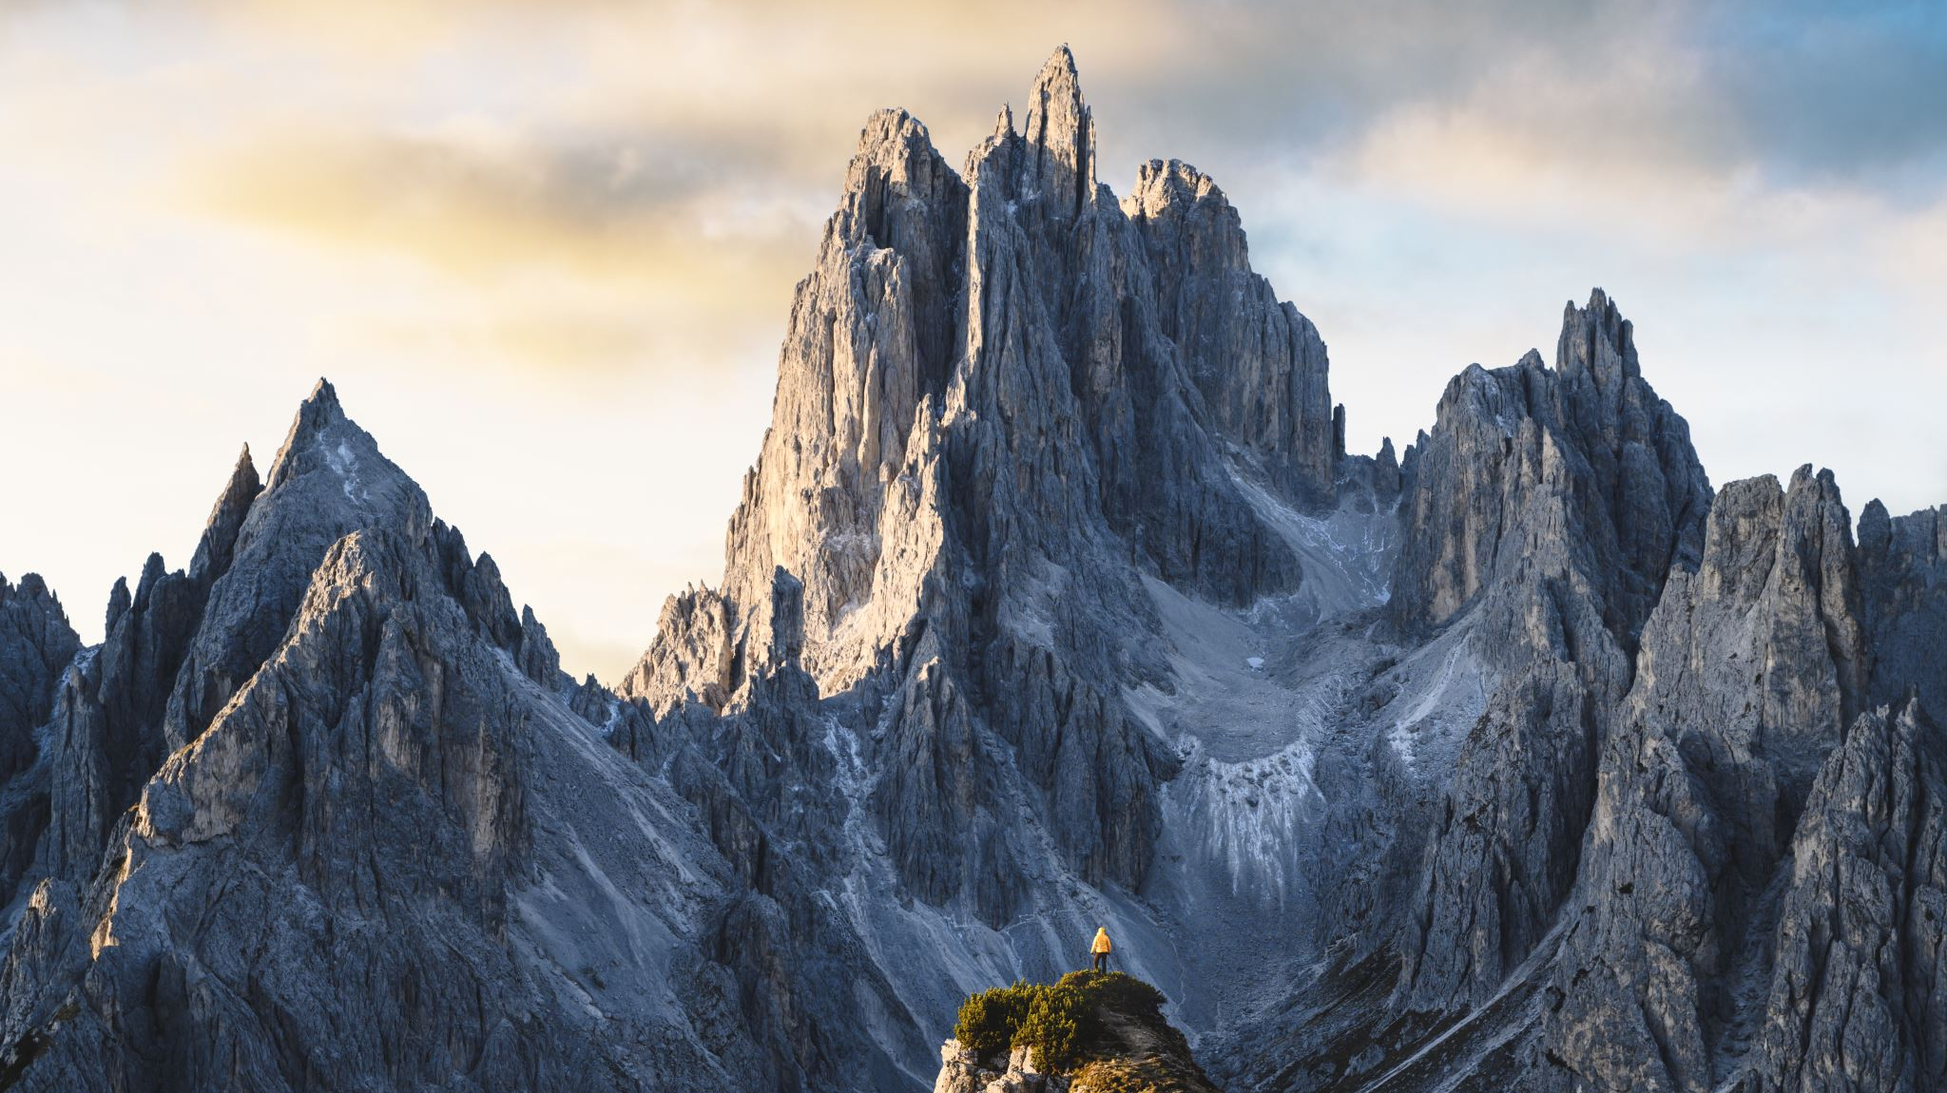
Big Mountain Resort Ticket Price Analysis
By Clement Chen

Slide 2
Problem
Big Mountain believes that it can charge more for ticket prices, however they want data to back up their decision
Recent additional ski lift increases operating costs by $1,540,000, would this generate more revenue?
What other changes to facilities would support higher ticket prices?

Slide 3
Recommendations
By market standards, Big Mountain is currently undercharging by ~ $10 for their facilities
Increase vertical drop by ~150 feet, runs by 1, and number of chairs by 1 would support a ticket price increase of about $2
Adding 4 acres of snowmaking area and increasing longest run by 0.2 miles will not be enough to support ticket price increases.
More information on operational costs in conjunction to the model will show what changes to make to the facilities to increase revenue

Slide 4
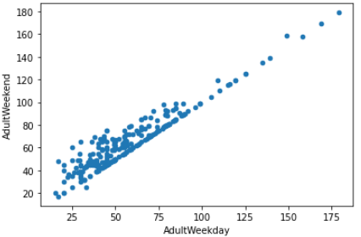
Modeling Process
The dataset was cleaned for errors and missing values
One feature, fastEight, was completely removed due to a lot of missing values and only 1 non-zero value and so would provide very little information. However, we should not just forget about this. Future analysis could be on average family/group size and see if a fastEight chair would be something customer would pay more for
We also decided to model only using Adult Weekend Prices as it has a strong correlation with Adult Weekday prices and had fewer missing values. Ticker prices in Montana were also the same for weekend and weekday

Slide 5
Modeling Process Cont.
First created a Linear Regressor model
Used feature selection method called SelectKBest that would select features that best explained variance in ticket price
Use k-fold cross validation to avoid overfitting on the same data
Used R^2, mean absolute error, and mean squared error to score our models

Slide 6
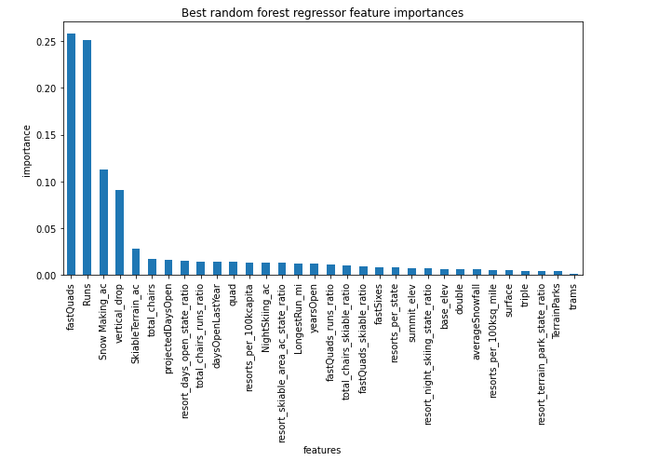
Modeling Process Cont.
We then tried using a random forest regressor which provided better scoring than our linear regressor
The random forest’s selected best features coincided with the best features from our linear regressor so we might be on t something…
Most important features seem to be fastQuads, Runs, Snow Making_ac, and vertical_drop

Slide 7
Summary
Big Mountain currently undercharges about $10 for their tickets
Facilities most important to customers and therefor ticket prices are fastQuads, Runs, Snow Making_ac, and vertical_drop
More information on operational costs are needed to determine which facilities to add or improve are worthwhile

